Slide 1
BUSINESS COMMUNICATION – I
Chapter - 3
Method and Modes of Communication
Prof. Muskan Jeswani

Slide 2
Methods of Communication
Method of Communication
Verbal Communication
Written Communication
Non Verbal Communication

Slide 3
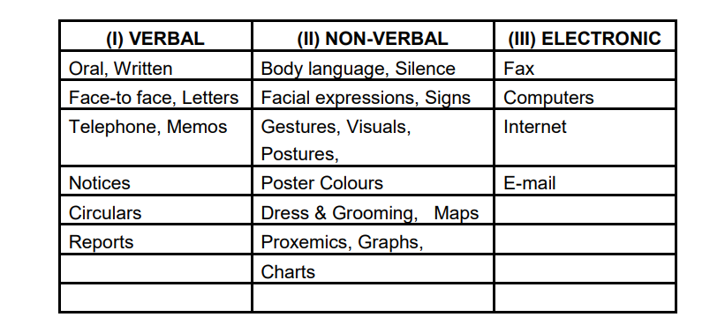

Slide 4

i). Verbal Communication: Verbal Communication uses language to communicate messages. Language uses spoken and written words; therefore verbal communication includes oral and written communication.

Slide 5
Oral communication: Oral communication is communication by means of the spoken word. It can take place as a face-to face meeting or over the telephone. It could be a personal and informal communication, or a formal interview, business meeting, a conference or a speech before an audience.
B. Principles of effective oral communication: Oral communication is a very effective and powerful medium. Effective oral communication depends on the speaker following certain principles. These principles are as follows :
Know your objective: You must know what you want your message to do – you may need to inform, to entertain, to convince, to express an opinion, or to explain.
Know your audience: Consider carefully the nature of your audience – their age, level of understanding, their occupations and their level of interest in your message.
Know your subject: Prepare your message thoroughly. See that you know your main ideas and key points. You must also know your facts and figures.
Know (how to use) your voice: A good speaker uses his voice to maximum advantage. Attention must be paid to volume, pitch, speed of speaking and correct pronunciation of words. Your voice must be clear, pleasing; and varied in volume, pitch and speed, to be interesting. Good delivery depends on using your voice well.
Know when to stop: The length of the oral message has a lot to do with its success. The message must aim for just the right length, neither too short nor too long. All points must be covered and yet there should be no repetitions or unnecessary elaboration.

Slide 6
C. Written Communication: Written communication is the expression of language by means of visible signs. Despite the far wider use of oral communication, modern civilization cannot function without the written form. Business organisations need it to run their systems efficiently and effectively. It should be noted that written communication is not merely oral communication written down. It has its own dynamics. Its importance is mainly in organising and documenting knowledge.
Advantages of written communication:
1. Reference: Written communication provides a permanent record. It can be filed and stored for future reference whenever needed.
2. Legal validity: It provides legal proof. Documents of importance are always stored in written form.
3. It aids memory and retention: the reader can go to the written matter again and again. This aids understanding as well as retention.
4. It is more accurate and organised. Written messages are drafted with greater time at our disposal; they are more accurate. The writer can edit and alter his message to make it as perfect as possible, and add the details needed. Words are chosen carefully to convey the exact meaning and matter is organised properly. This makes written communication an essential part of every business organisation.
5. Fixing responsibility: Written documents are always signed; hence it is possible to fix responsibility on a certain person or group of persons. 6. Wider reach: Written messages have a wider reach than oral messages, as printing and photocopying 45 make it possible to transmit messages easily to a very large number of people

Slide 7
NON – VERBAL COMMUNICATION TO BE CONTINUED IN NEXT PPT.

